Slide 1
White Point Landslipe
Palos Verdes, CA
By Christian Kesler, Savannah Keane, and Sarva Pulla

Slide 2
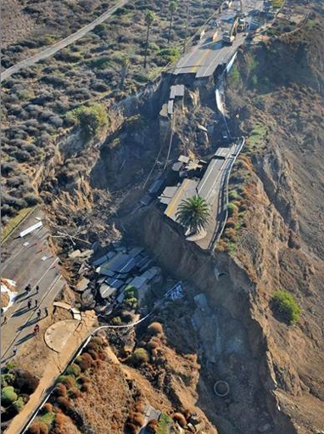
Site information
Palos Verdes, CA
On a bluff overlooking the Pacific Ocean
Roadway along top of the bluff

Slide 3
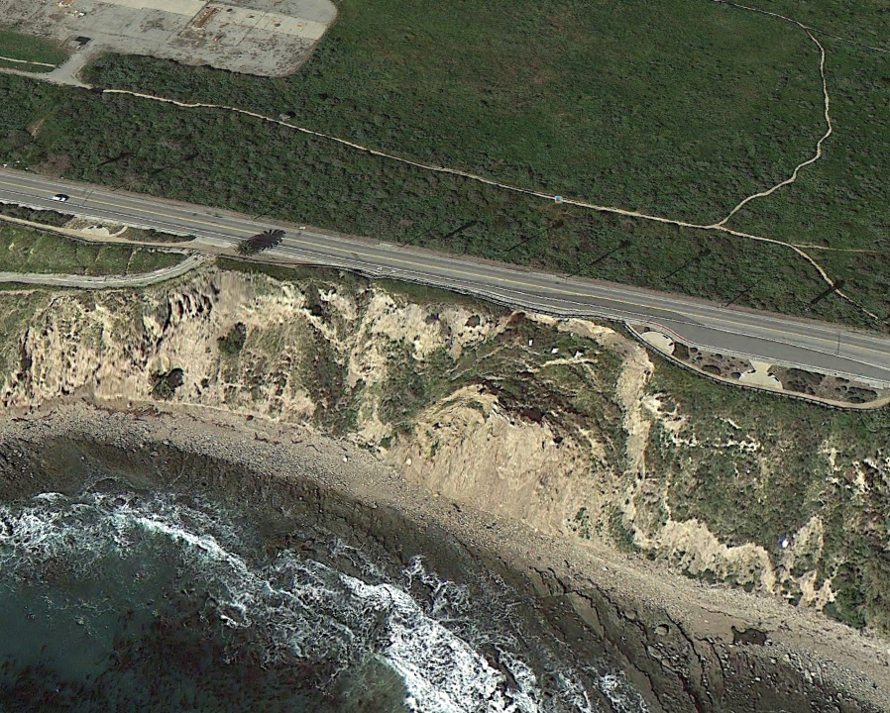
Before failure - 2011

Slide 4
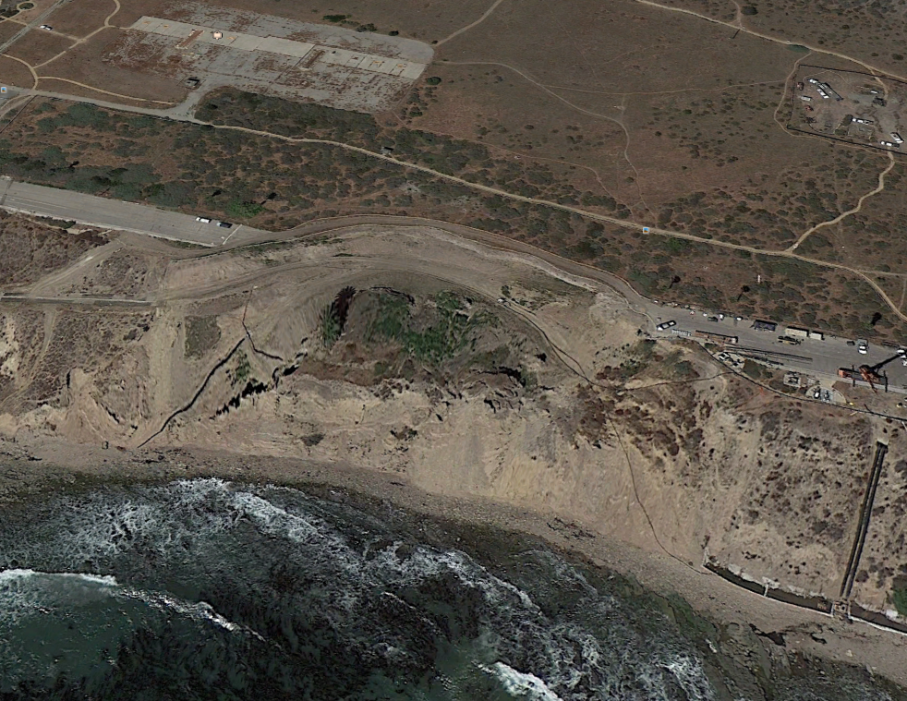
After failure - 2013

Slide 5
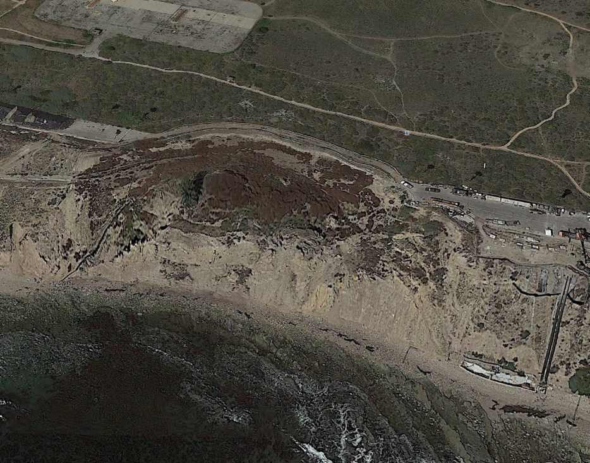
After failure - 2014

Slide 6
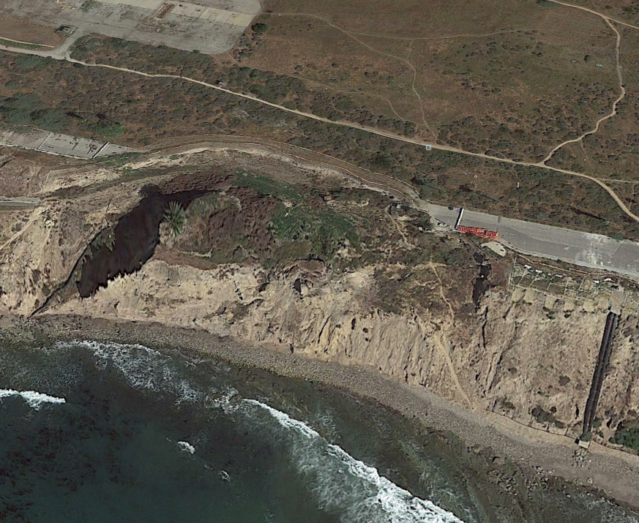
After failure - 2015

Slide 7
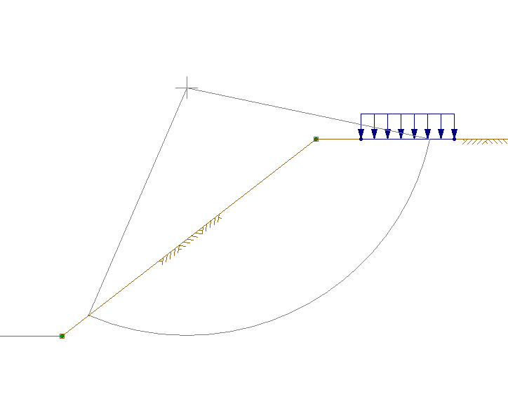
Utexas analysis before failure
Setup the location
Found distances and slope from Google Earth
Distributed load for the roadway

Slide 8
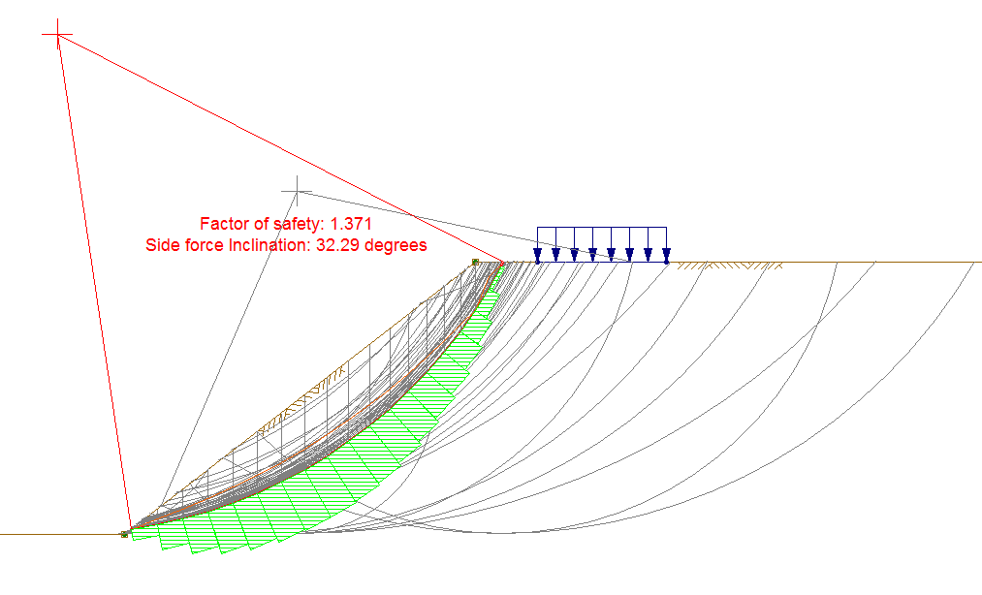
Utexas analysis before failure

Slide 9
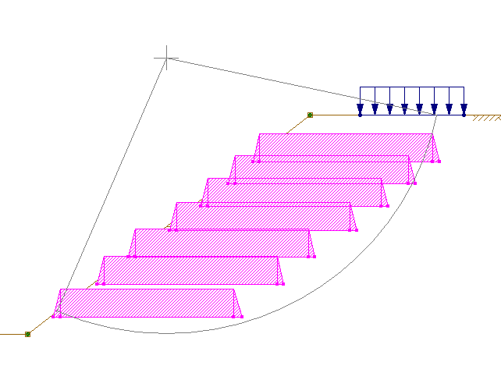
Utexas pre-emptive solution
7 Reinforcement Lines
108 feet in length
Total cost is approximately $453,000

Slide 10
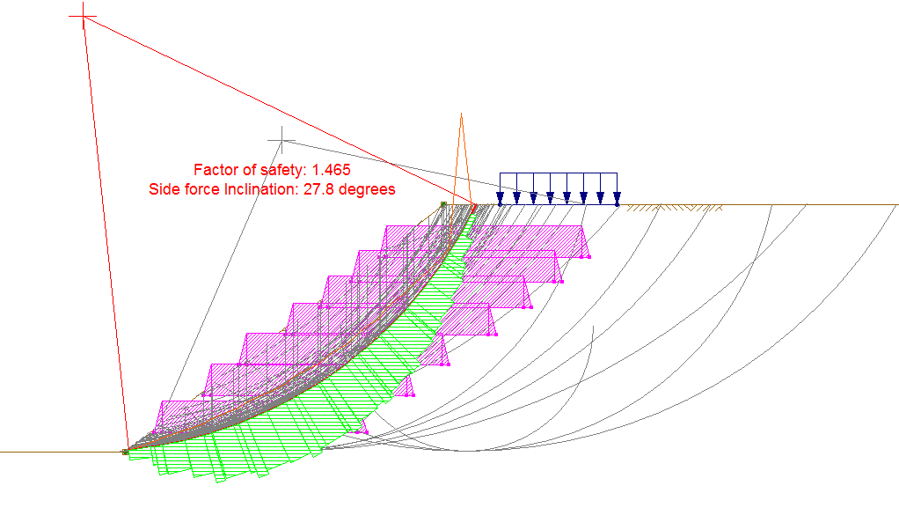
UTExas pre-emptive solution

Slide 11
results
Actual failure OF SLOPE
pre-emptive failure with reinforcements
FS = 1.371
COST TO FIX = $32,000,000
FS = 1.465
COST TO PREVENT = $453,000

Slide 12
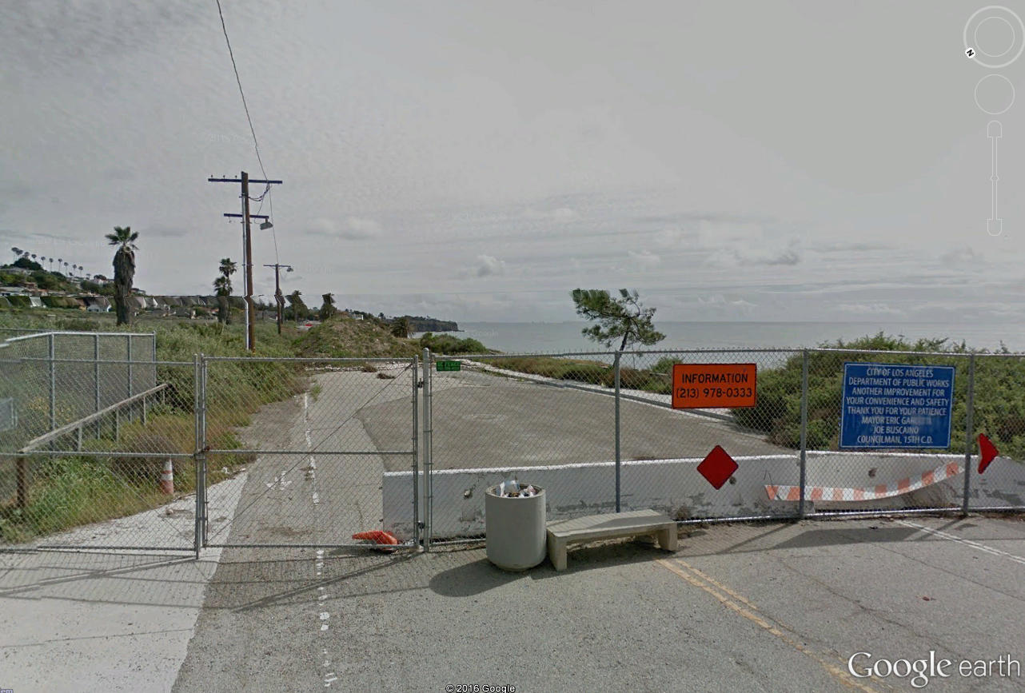
CURRENT CONDITIONS
Currently the road is blocked off on both sides of the slide
Construction to begin in 2019
Expected construction time is 2 years

Slide 13
Recommendations
Dewatering on the eastern flank
Slope anchoring using post-tensioned tieback anchors
Reinforced Soil Slope (Granular Fill with steel or geosynthetic reinforcement)
Retaining Wall
Bridge
Regrading

Slide 14
END
References
http://eng.lacity.org/whitepoint/White%20Point%20Final%20Main%20Body.pdf
http://www.geotechdata.info/parameter/angle-of-friction.html
http://www.geotechdata.info/parameter/cohesion.html
http://www.geotechnicalinfo.com/soil_unit_weight.html

